Slide 1


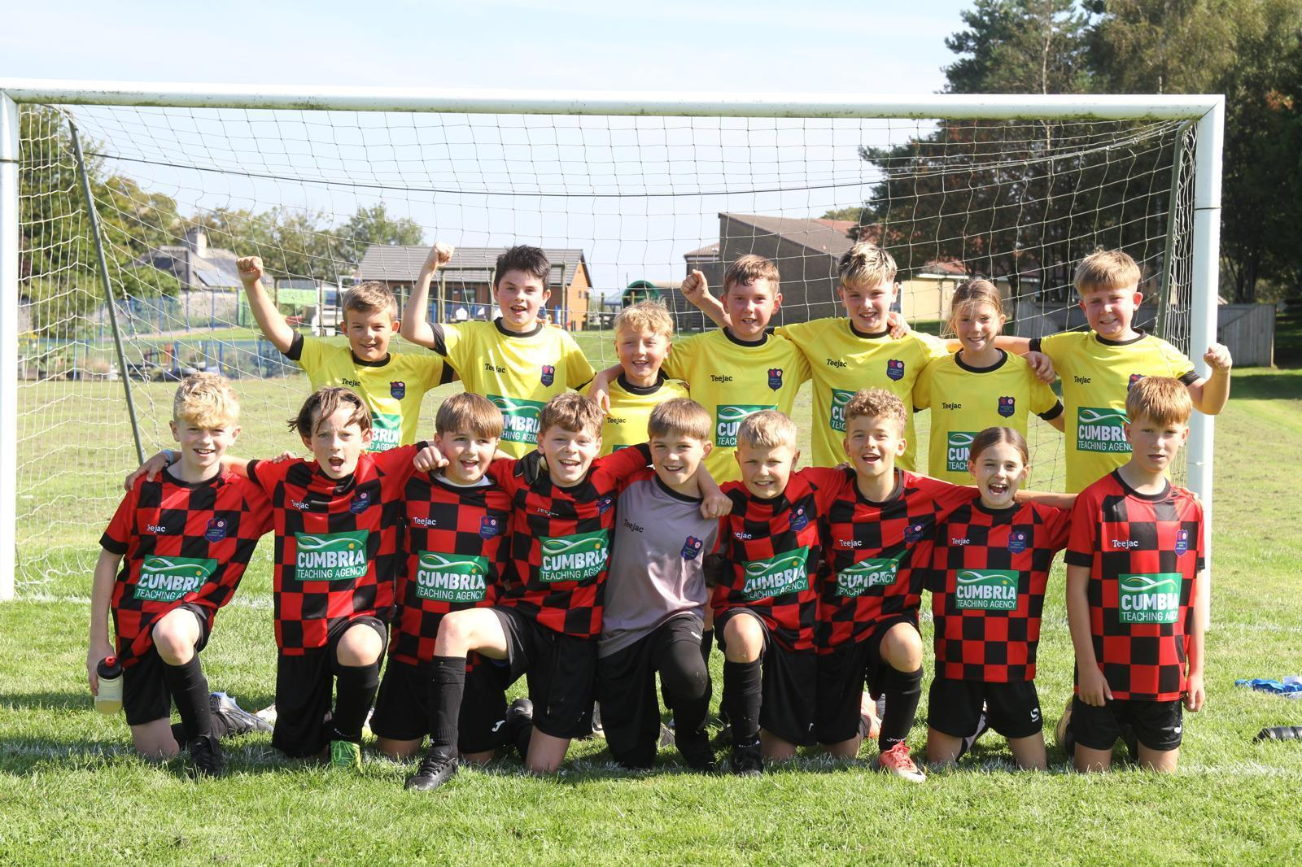


Swarthmoor Junior Football Club members handbook 25/26
We are proud to be an England Accredited Club
https://www.facebook.com/profile.php?id=100066302486457&mibextid=wwXIfr

Slide 2
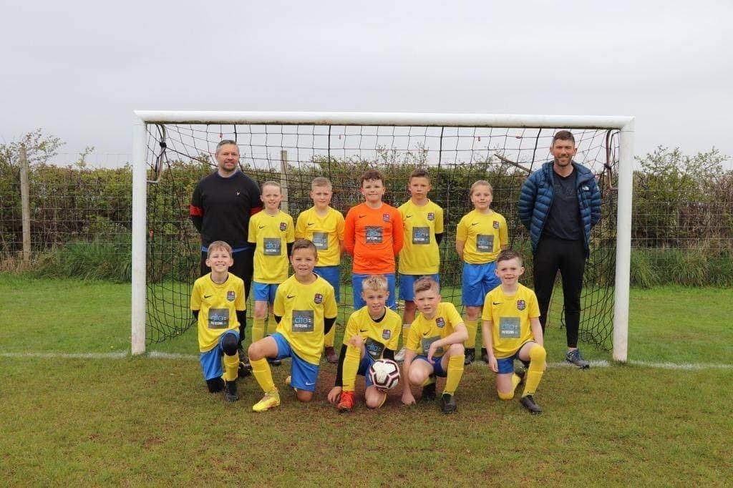
Swarthmoor Junior Football Club
future vision
Our aim is to be a club which is valued and respected by the community, who understand and respect the needs of all involved: players; parents; officials and volunteers.
We aim, to provide a safe, secure and supportive environment for children to play football and to develop their footballing ability. Our emphasis will be on creating a fun environment where all involved can enjoy the experience and for our players to develop as players and as young people.
Nothing is more important to us than the welfare and well-being of our young people.
We also aim to develop the structure of the club both in terms of committee, volunteers and club infrastructure to become a respected, sustainable part of the community.
We aspire to create a stronger link between the junior football club and the senior Swarthmoor team. Our ultimate aim is to produce players who enjoy football and will continue to play into adulthood at the highest level they can achieve.
Swarthmoor JFC Club Ethos
Our overall success will be measured by the development of the players' football skills and the enjoyment of the game by our players. A further measure of our success will be the number of junior members and volunteers we have involved with the club and how they develop and improve.
Our ethos with respect to football will be to develop rounded players both in terms of skill and tactical awareness by age appropriate means. For younger players this will focus on developing players who are comfortable on the ball, with good technical skills and able to make their own decisions during a match. For our older players we will develop greater understanding and an appreciation of the whole game including in-possession as well out-of-possession football.
Our capacity to accept new players is often limited by the number of volunteer coaches we have to run training sessions and matches. We introduce kids and potential future volunteers to football/volunteering through our future stars programmes. The intent is to get kids and supporters to engage with the club and help our teams and community thrive. All grassroots clubs rely on every and all contributions from volunteers.

Slide 3
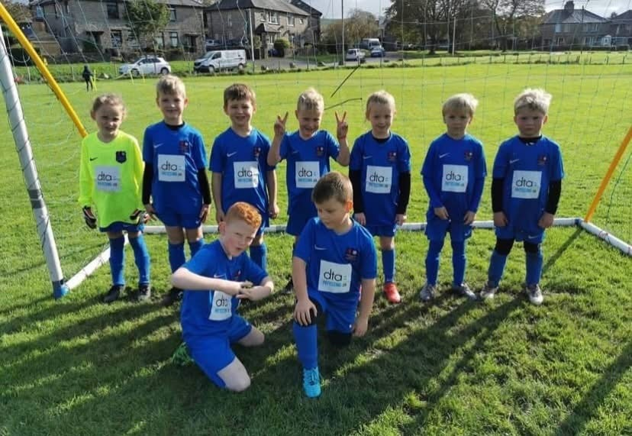
As a club we are committed to following the FA's Respect programme and expect all involved: coaches; players; parents and spectators to do so.
At all ages, coaches will not tolerate poor gamesmanship, poor sporting behaviour, dangerous play or spectator behaviour and will take action. In some cases this may be a temporary measure to allow the things to calm down and this will be left to the discretion of the coach.
The safety of our players is paramount and we aim to have all our coaches achieve at least a FA coaching qualification, obtain a Criminal Records Check (DBS) as well as First Aid and safeguarding children qualifications. The club will also have at least one child welfare officer.
The club adopts an ethos where teams are developed and entered into local leagues.
Approach on match days
Selection for match day is dependent on a vast number of factors which the coach is accountable for however minimum expectations are a positive attitude, good behaviour and attendance at training.
Start at the beginning: Future Stars Programme
We run a Future Stars programme which is a pipeline from toddlers through to our most junior squad where kids learn the fundamentals of football.
Developmental Football
Under 7s, 8s, 9s 10s & 11s
A rotation of the full squad should be employed to ensure all players in the squad get an equal opportunity to play matches during the season.
During matches a rotation system should also be employed to ensure all players get experience in all positions during matches.
Competitive Football
Under 12s & above
All players in the squad will have the opportunity to play a reasonable number of matches during the season.
Rotation of position should continue to be encouraged to continue to develop players. Playing in different positions will continue to be encouraged although it is recognised that players start to settle into favoured
positions.

Slide 4
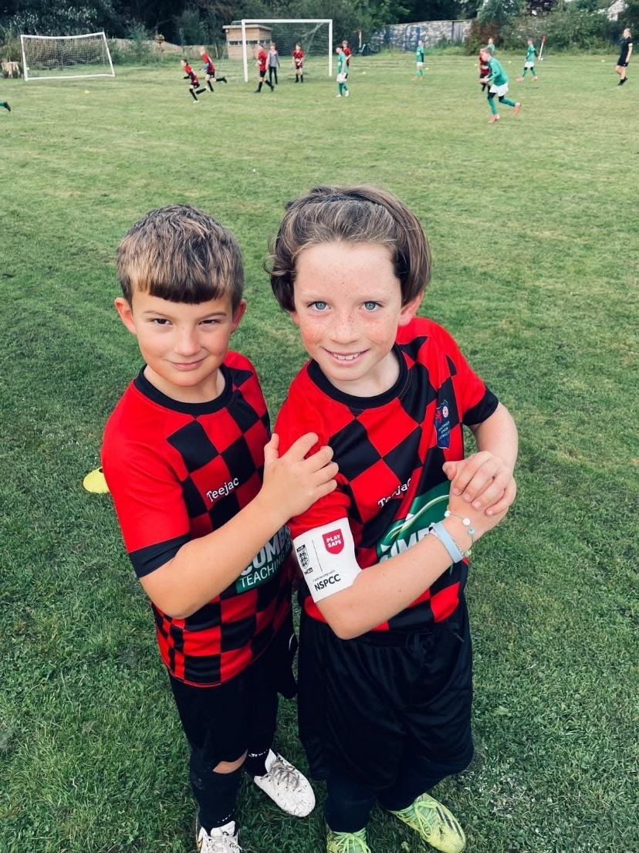
Respect Code of Conduct – Players
• Respect all involved within the game: your own team; the opposition players; coaches; the match officials and the spectators
• Respect the match officials and accept their decisions
• Always play to the best of my ability
• Always play by the laws of the game and never engage in any forms of gamesmanship or timewasting
• Never engage in offensive, insulting or abusive language or Behaviour
I understand that if I do not follow the Code, the following actions may be taken:
• Be required to apologise to my teammates, the other team, referee or team coach.
• Receive a formal warning from the coach or the club committee.
• Be substituted or miss the next game(s).
• Be suspended from training.
• Be required to leave the club.
In addition:
• My club, County FA or the FA may make the parent or carer aware of any infringements of the Code of Conduct.
Respect CoC: Coaches and team officials
• Respect all involved with the game: your own team; the opposition players; coaches; the match officials and the spectators
• Always direct the team to play by the laws of the game and never engage in any forms of gamesmanship or timewasting
• Always respect the match official's decision and never engage in public criticism of the match officials
• Never engage in offensive, insulting or abusive language or
behaviour.
When working with players:
• Promote positive thinking and language in all aspects with the kids
• As a priority provide a safe, fair, secure and supportive environment that allows players to develop
• Encourage hard work and commitment as opposed to just focussing on the result of a match
• Ensure all activities organised are appropriate for the players’ ability, age and maturity
• Implement a zero tolerance of illegal or unsporting influences including banned substances and techniques.
I understand that if I do not follow the Code, the following actions may be taken:
• Required to meet with the club committee, league or County
FA Welfare Officer
• Monitored by another coach from the club
• Required to attend an FA education course
• Referred to through the grievance procedure

Slide 5
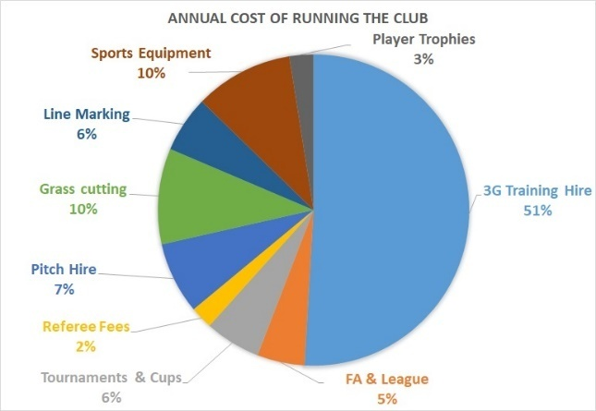
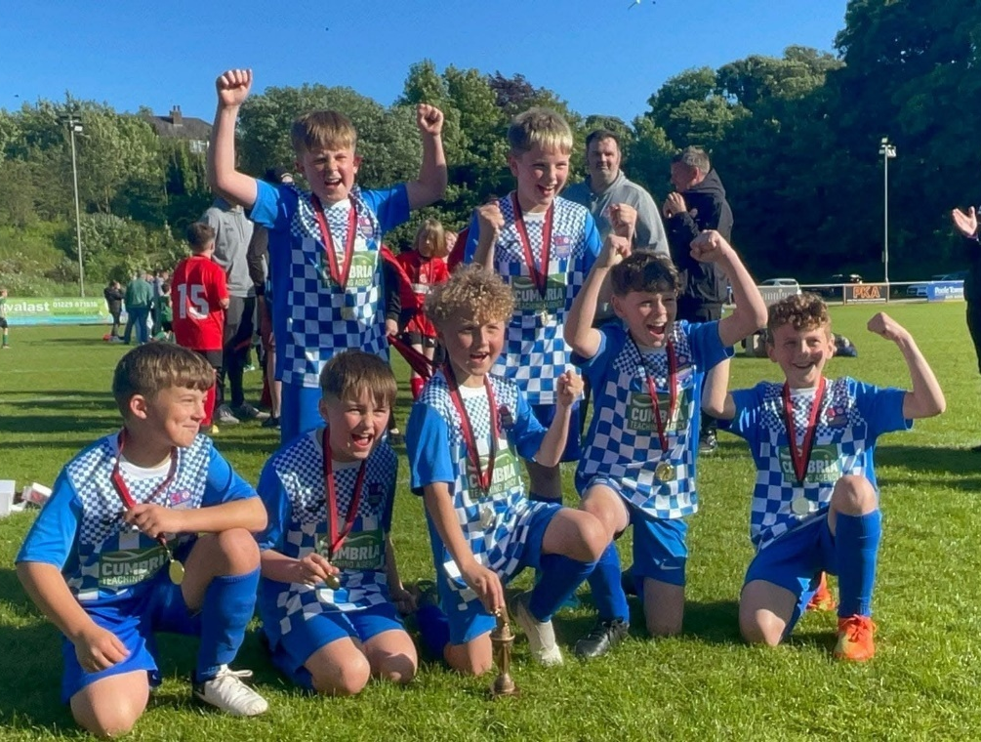
Parents/ Supporters
• Respect all involved with the game: your own team; the opposition players; coaches; the match officials and the spectators
• Applaud the opposition as well as your own team
• Volunteer in a role within the club
• Avoid coaching your child during the game
• Respect the decisions of match officials and coach
• Give attention to each child involved
• Be positive and encouraging to everyone involved
• Remain behind any physical barrier (fence/ line/ cones) during the match and do not encroach to within 2m of the touchline or stand behind the goal
• Avoid criticising mistakes
• Never engage in aggressive, negative or abusive language or behaviour
I understand that if I do not follow the Code, the
following actions may be taken:
• Issued with a verbal warning from a club or league official
• Obliged to leave the match/training venue by the club
• Obliged to undertake an FA education course
• Required to meet with the club committee, league or
County FA Welfare Officer
• Requested by the club not to attend future games
• Required to leave the club along with any dependants
Additional Information
Game roles: From under 11's football it is a match day requirement for teams to provide:
1) referee 2) lines-person and 3) respect marshal to check the use of the code of conduct for behaviours
The coaches cannot effectively coach and carry out these additional roles so fulfilling these roles is essential, and greatly appreciated, for games to happen.
The Boot Bank: We run a boot bank programme where kids can pass on their old boots/trainers that they have outgrown.
Club Costs: There is a cost to running the club and your subscription fee's cover this as shown below;

Slide 6
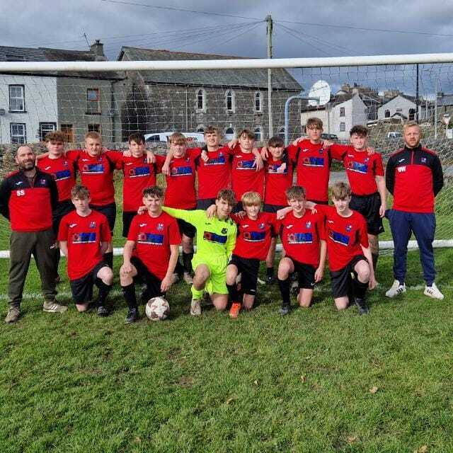
Volunteers
The success and ongoing development of Swarthmoor Junior Football Club is dependent on maintaining and growing its team of volunteers. We currently need around 20 coaches as well as a significant number of volunteers undertaking behind the scenes roles which are not always visible to all involved with the club.
If you would like to join our great team please get in touch - we are always keen to hear from anyone who would like to help out in any way. Without you it doesn’t work…
The Volunteers |  |  | The Coaches
Secretary | Andrew McKenna |  | U7 | VACANT
Treasurer | Leighton Harker |  | U8 | Mike Frost
Welfare Officers | Julie-Ann McKevitt |  | U8 | Sean Gardner
Chairperson | Keith Skinner |  | U8 | Melo Elliot
 |  |  | U8 | Chris Rood
Pitch Improvement Group | Aaron Kavanagh |  | U9 | Mark McKinley
 | Carl Rigg |  | U9 | Mark McGrath
 | Phil Thorne |  | U9 | Dan Laisby
 | Sean Sedgewick |  | U10 | Joe English
 |  |  | U10 | Danny Flooks
Grants | Leighton Harker |  | U10 | Duane Bell
 |  |  | U10 | David Lomas
Socials/fundraising | Alison Kavanagh |  | U11 | /
 | Sarah-Jane Rigg |  | U12 | Michael Mitchell
 | Dinga Bell |  | U12 | Dan Charnley
 | Laura McKinley |  | U12 | James Eccles
 | Phil Thorne |  | U12 | Keith Skinner
 | Carl Rigg |  | U13 | Andy McKenna
 | Megan Hawkes |  | U13 | Adam Williamson
Club Shop | Joe English |  | U13 | Jordan Spencer
Burnley Trip | Danny Flooks |  | U14 | Phil Thorne
Quartermaster | Michael Mitchell |  | U14 | Leighton Harker
SJFC Tournament Co-ordinator | VACANT |  | U15 | /
Boot Exchange | Mike Frost |  | U16 | Sean Sedgewick
Line Marking | VACANT
Grass Cutting | Mark McKinley
Social Media | Sarah Jane Rigg

Slide 7

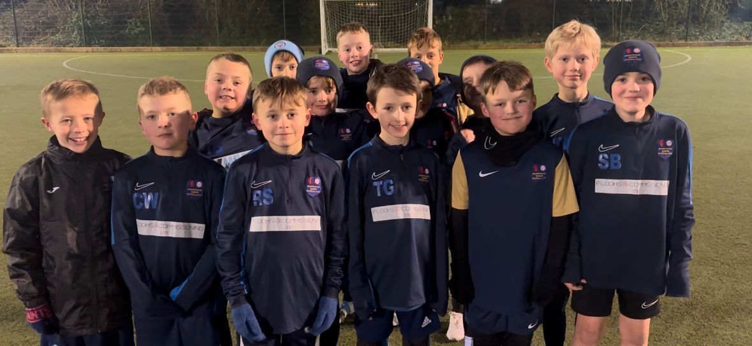
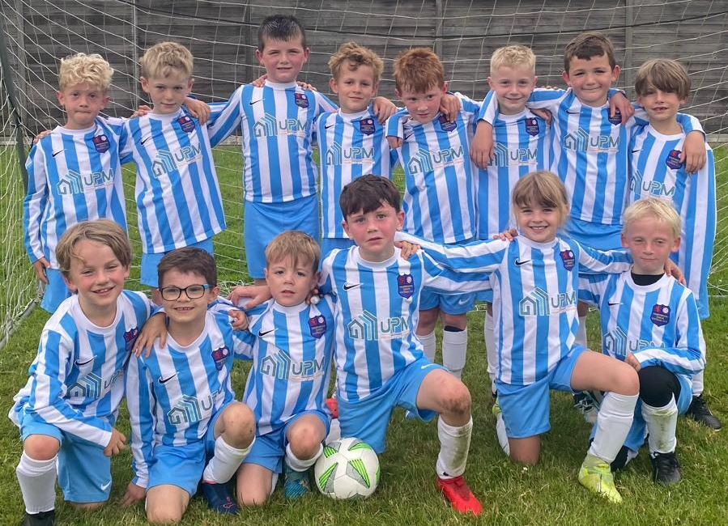
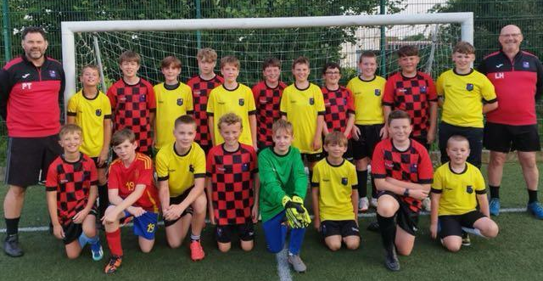
Our Community Partners
SJFC is open to people of all ethnicities, nationalities, sexual orientations, religions or beliefs, sexes, ages and ability

Slide 8
Summary of the Season

